Slide 1
LINQ Operators
Continuous staff improvement
Sergiu Grajdean

Slide 2
OBjectives
Standard Query Operators Overview
Filtering
Projection
Joining
Ordering
Grouping
Set Operators
Conversion Methods
Element Operators
Aggregation Methods
Quantifiers
Generation Methods
Closures

Slide 3
Standard Query Operators Overview
The standard query operators are the methods that form the Language-Integrated Query (LINQ) pattern
The standard query operators fall into three categories:
Sequence in, sequence out (sequence-to-sequence)
IEnumerable<TIn> → IEnumerable<TOut>
Sequence in, single element or scalar value out
IEnumerable<TSource> → scalar
Nothing in, sequence out (generation methods)
void → IEnumerable<TResult>

Slide 4
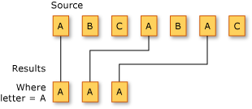
Filtering
Filtering refers to the operation of restricting the result set to contain only those elements that satisfy a specified condition. It is also known as selection.
The pattern type is IEnumerable<TSource> → IEnumerable<TSource>
Number of elements returned after filtering operation is equals or less than number of input collection.

Slide 5
Filtering
Main filtering methods are:
Method | Description
Where | Returns a subset of elements that satisfy a given condition
Take | Returns the first count elements and discards the rest
Skip | Ignores the first count elements and returns the rest
TakeWhile | Emits elements from the input sequence until the predicate is false
SkipWhile | Ignores elements from the input sequence until the predicate is false, and then emits the rest
Distinct | Returns a sequence that excludes duplicates

Slide 6
Filtering
Example
int[] col = new int[] {1, 2, 3, 4, 5, 6, 7, 8, 1,2};
var odds = col.Where(x => x % 2 != 0); //odds={1,3,5,7,1}
var first2 = col.Take(2); //first2={1,2}
var last3 = col.Skip(5); //last3={6,7,8,1,2}
var lst5 = col.TakeWhile(x => x < 5); //lst5={1,2,3,4}
var gtt5 = col.SkipWhile(x => x < 5); //gtt5={5,6,7,8,1,2}
var distinct = col.Distinct(); //distinct={1,2,3,4,5,6,7,8}

Slide 7
Projection
Projection refers to the operation of transforming an object into a new form that often consists only of those properties that will be subsequently used
The pattern type is IEnumerable<TSource> → IEnumerable<TResult>
Number of elements of resulting collection is the same as input collection
Main Projection methods are:
Method | Description
Select | Transforms each input element with the given lambda expression
SelectMany | Transforms each input element, and then flattens and concatenates the resultant subsequences

Slide 8
Projection
Select example
class User{
public string FirstName { get; set; }
public string LastName { get; set; }
}
private void ProjectionExample()
{
var users = new[]
{
new User {FirstName = "John", LastName = "Ohnon"},
new User {FirstName = "Sarah", LastName = "Connor"},
new User {FirstName = "Robbie", LastName = "Williams"},
};
IEnumerable<string> lastNames = users.Select(x => x.LastName);
}

Slide 9
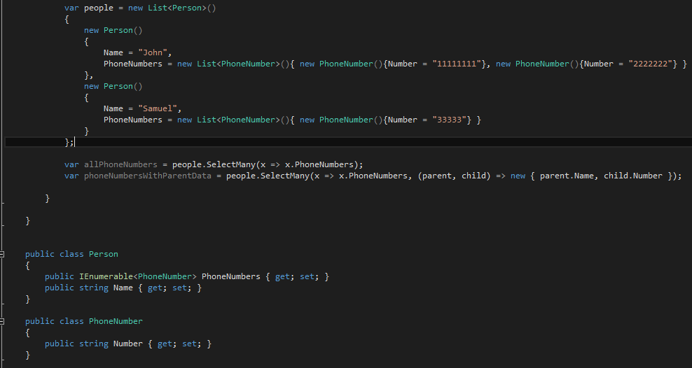
Projection
SelectMany example

Slide 10
Joining
The join clause is useful for associating elements from different source sequences that have no direct relationship in the object model
The pattern type is IEnumerable<TFirst>, IEnumerable<TSecond> → IEnumerable<TResult>
Main Joining methods are:
Method | Description
Join | Applies a lookup strategy to match elements from two collections, emitting a flat result set
GroupJoin | As above, but emits a hierarchical result set
Zip | Enumerates two sequences in step (like a zipper), applying a function over each element pair

Slide 11
Joining
Join example
class Person
{
public string Name { get; set; }
}
class Pet
{
public string Name { get; set; }
public Person Owner { get; set; }
}

Slide 12
Joining
Person magnus = new Person { Name = "Hedlund, Magnus" };
Person terry = new Person { Name = "Adams, Terry" };
Person charlotte = new Person { Name = "Weiss, Charlotte" };
Pet barley = new Pet { Name = "Barley", Owner = terry };
Pet boots = new Pet { Name = "Boots", Owner = terry };
Pet whiskers = new Pet { Name = "Whiskers", Owner = charlotte };
Pet daisy = new Pet { Name = "Daisy", Owner = magnus };
List<Person> people = new List<Person> { magnus, terry, charlotte };
List<Pet> pets = new List<Pet> { barley, boots, whiskers, daisy };
var query =
people.Join(pets,
person => person,
pet => pet.Owner,
(person, pet) =>
new { OwnerName = person.Name, Pet = pet.Name });

Slide 13
Ordering
Ordering operators return the same elements in a different order
The pattern type is IEnumerable<TSource> → IOrderedEnumerable<TSource>
Main Ordering methods are:
Method | Description
OrderBy, ThenBy | Sorts a sequence in ascending order
OrderByDescending, ThenByDescending | Sorts a sequence in descending order
Reverse | Returns a sequence in reverse order

Slide 14
Grouping
Organizes a flat input sequence into sequences of groups
The pattern type is
IEnumerable<TSource> → IEnumerable<IGrouping<TSource,TElement>>
Main Grouping methods are:
Method | Description
GroupBy | Groups a sequence into subsequences

Slide 15
Set Operators
Represents main operations from set theory
The pattern type is IEnumerable<TSource>, IEnumerable<TSource>→IEnumerable<TSource>
Main Set operators are:
Method | Description
Concat | Returns a concatenation of elements in each of the two sequences
Union | Returns a concatenation of elements in each of the two sequences, excluding duplicates
Intersect | Returns elements present in both sequences
Except | Returns elements present in the first, but not the second sequence

Slide 16
Conversion Methods
Converts primary sequence in another type of sequence
Main Conversion methods are:
Method | Description
OfType | Converts IEnumerable to IEnumerable<T>, discarding wrongly typed elements
Cast | Converts IEnumerable to IEnumerable<T>, throwing an exception if there are any wrongly typed elements
ToArray | Converts IEnumerable<T> to T[]
ToList | Converts IEnumerable<T> to List<T>
ToDictionary | Converts IEnumerable<T> to Dictionary<TKey,TValue>
ToLookup | Converts IEnumerable<T> to ILookup<TKey,TElement>
AsEnumerable | Downcasts to IEnumerable<T>
AsQueryable | Casts or converts to IQueryable<T>

Slide 17
Element Operators
Returns one element from set
The pattern type is IEnumerable<TSource>→ TSource
Main Element operators are:
Method | Description
First, FirstOrDefault | Returns the first element in the sequence, optionally satisfying a predicate
Last, LastOrDefault | Returns the last element in the sequence, optionally satisfying a predicate
Single, SingleOrDefault | Equivalent to First/First OrDefault, but throws an exception if there is more than one match
ElementAt, ElementAtOrDefault | Returns the element at the specified position
DefaultIfEmpty | Returns a single-element sequence whose value is default(TSource) if the sequence has no elements

Slide 18
Aggregation Methods
Enumerate a sequence and returns a scalar value
The pattern type is IEnumerable<TSource>→ scalar
Main Aggregation methods are:
Method | Description
Count, LongCount | Returns the number of elements in the input sequence, optionally satisfying a predicat
Min, Max | Returns the smallest or largest element in the sequence
Sum, Average | Calculates a numeric sum or average over elements in the sequence
Aggregate | Performs a custom aggregation

Slide 19
Quantifiers
Returns a bool value if sequence satisfies a condition
The pattern type is IEnumerable<TSource>→ bool
Main Quantifier methods are:
Method | Description
Contains | Returns true if the input sequence contains the given element
Any | Returns true if any elements satisfy the given predicate
All | Returns true if all elements satisfy the given predicate
SequenceEqual | Returns true if the second sequence has identical elements to the input sequence

Slide 20
Generation Methods
Returns a bool value if sequence satisfies a condition
The pattern type is void→IEnumerable<TResult>
Main Generation methods are:
Method | Description
Empty | Creates an empty sequence
Repeat | Creates a sequence of repeating elements
Range | Creates a sequence of integers

Slide 21
Closures
Closure is a function along with its lexical environment (available variables and their values) when the function is created.
From the definition of Closure it can be inferred that Closure remembers the values of the variables during its creation. However in C# the outer local variable is shared with the anonymous method by creating it on the heap.
When a local variable is captured into a closure a helper class is created and the variable is transformed into a property.
A captured variables lives for at least as long as any delegate instance referring to it.

Slide 22
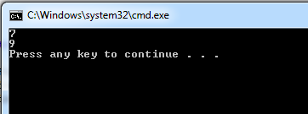
Closures
Example of closure
static void Main(string[] args)
{
var inc = GetAFunc();
Console.WriteLine(inc(5));
Console.WriteLine(inc(6));
}
public static Func<int, int> GetAFunc()
{
var myVar = 1;
Func<int, int> inc = delegate(int var1){
myVar = myVar + 1;
return var1 + myVar;
};
return inc;
}

Slide 23
Closures
internal class MyClass
{
private class __AnonymousClass{
public int myVar;
public int __AnonymousMethod1(int var1){
myVar = myVar + 1;
return var1 + myVar;
}}
private static void Main(string[] args){
var inc = GetAFunc();
Console.WriteLine(inc(5));
Console.WriteLine(inc(6));
}
public static Func<int, int> GetAFunc(){
var __anonymousClass = new __AnonymousClass();
__anonymousClass.myVar = 1;
return __anonymousClass.__AnonymousMethod1;
}
}

Slide 24
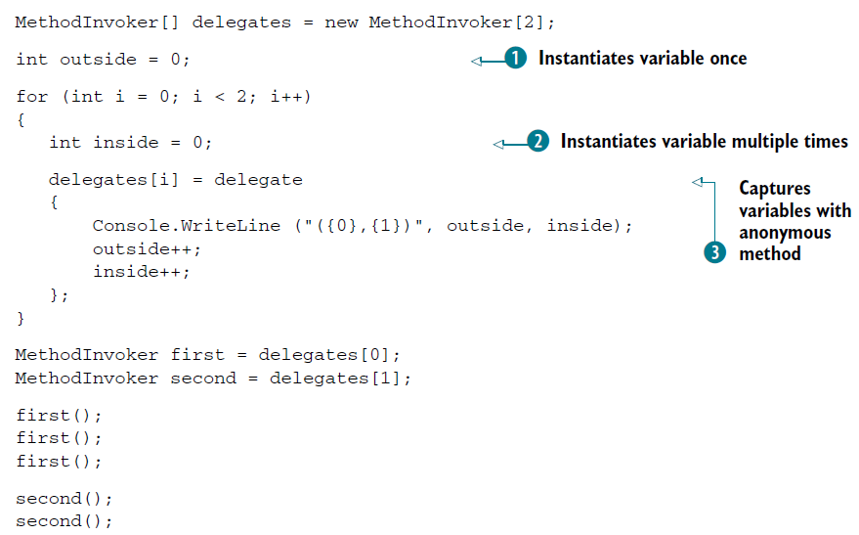
Closures
Example of closure

Slide 25
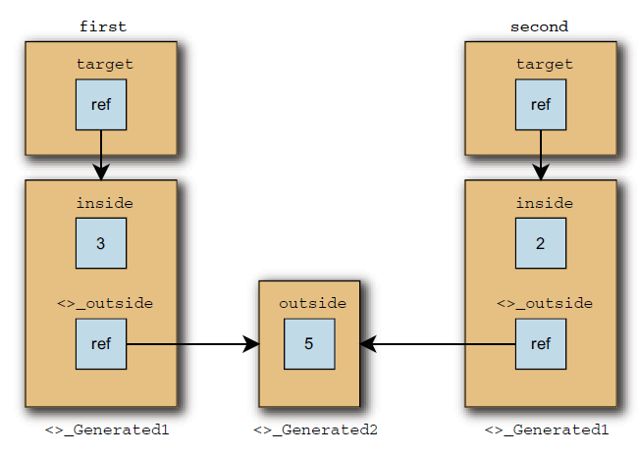
Closures
Snapshot of multiple captured variable scopes in memory

Slide 26
Assignment
Create one or more sequences and use at least one operator of each type
Use closures in operations

Slide 27
References
Albahari J, Albahari B (2012). C# 5.0 in a Nutshell.
Anonymous methods and closures in C#
The implementation of anonymous methods in C# and its consequences (part 1)
C# Closures Explained

Slide 28
Revisions
Number | Author | Date | Description
1.0.0 | Serghei Grajdean | 07.12.2015 | Initial version
1.1.0 | Serghei Grajdean | 23.02.2016 | Joining example added, minor changes

